Slide 1

The Zen of
Coding

Slide 2




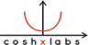
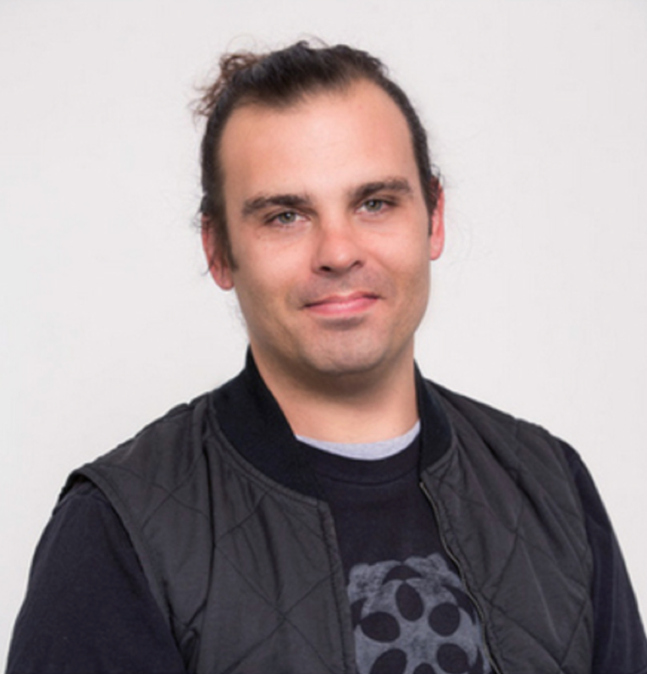

Instructor - Jerome Chenette
Code Related
Over 15 years coding, (with plenty of experience being a n00b at it.)
Teaching and Curriculum Design for the past 4 years
Worked in the Node, Ruby, and Python Community
Instructed the Data and Web Dev Course (15th class), 3rd online
International Traveler , Outdoor Enthusiast
Cat Lover & new Dad
Prior subscriber to the man bun movement - self stylist
Former SF || Now North Bay
Taught surfing, ESL, Snowboarding

Slide 3
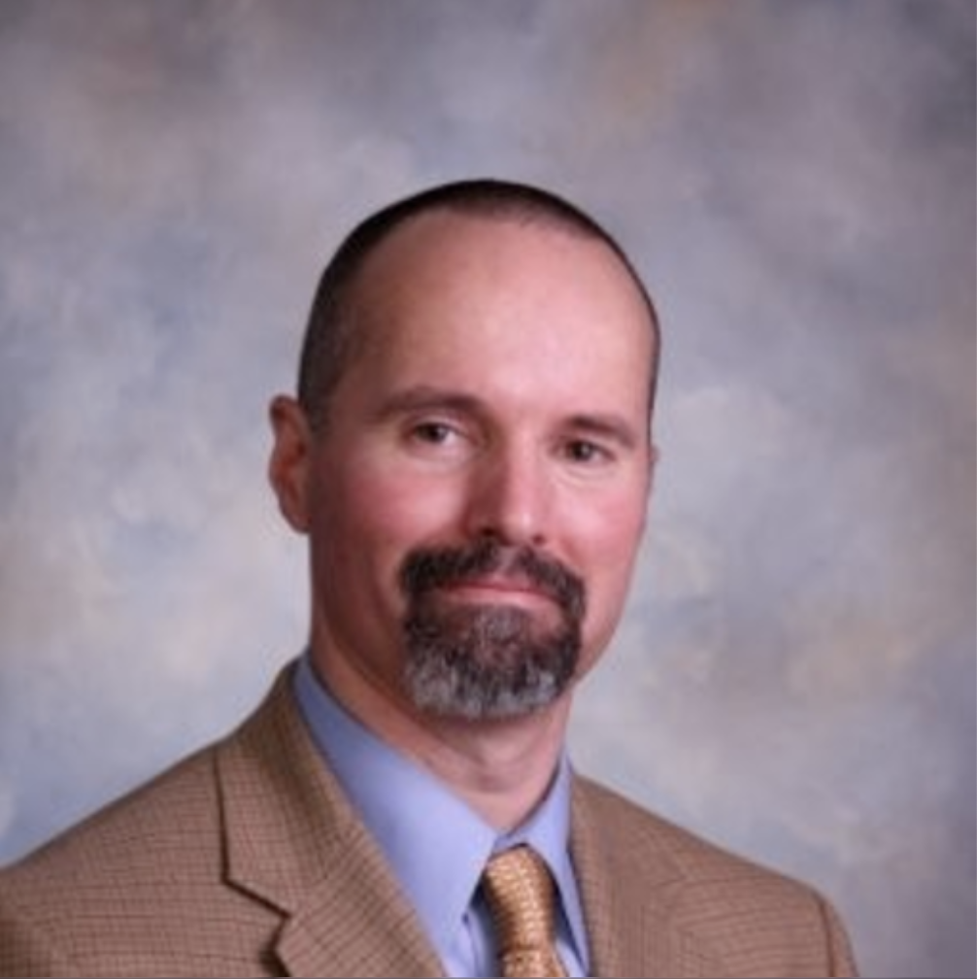
Instructional Team
Jerome
Manuel

Slide 4
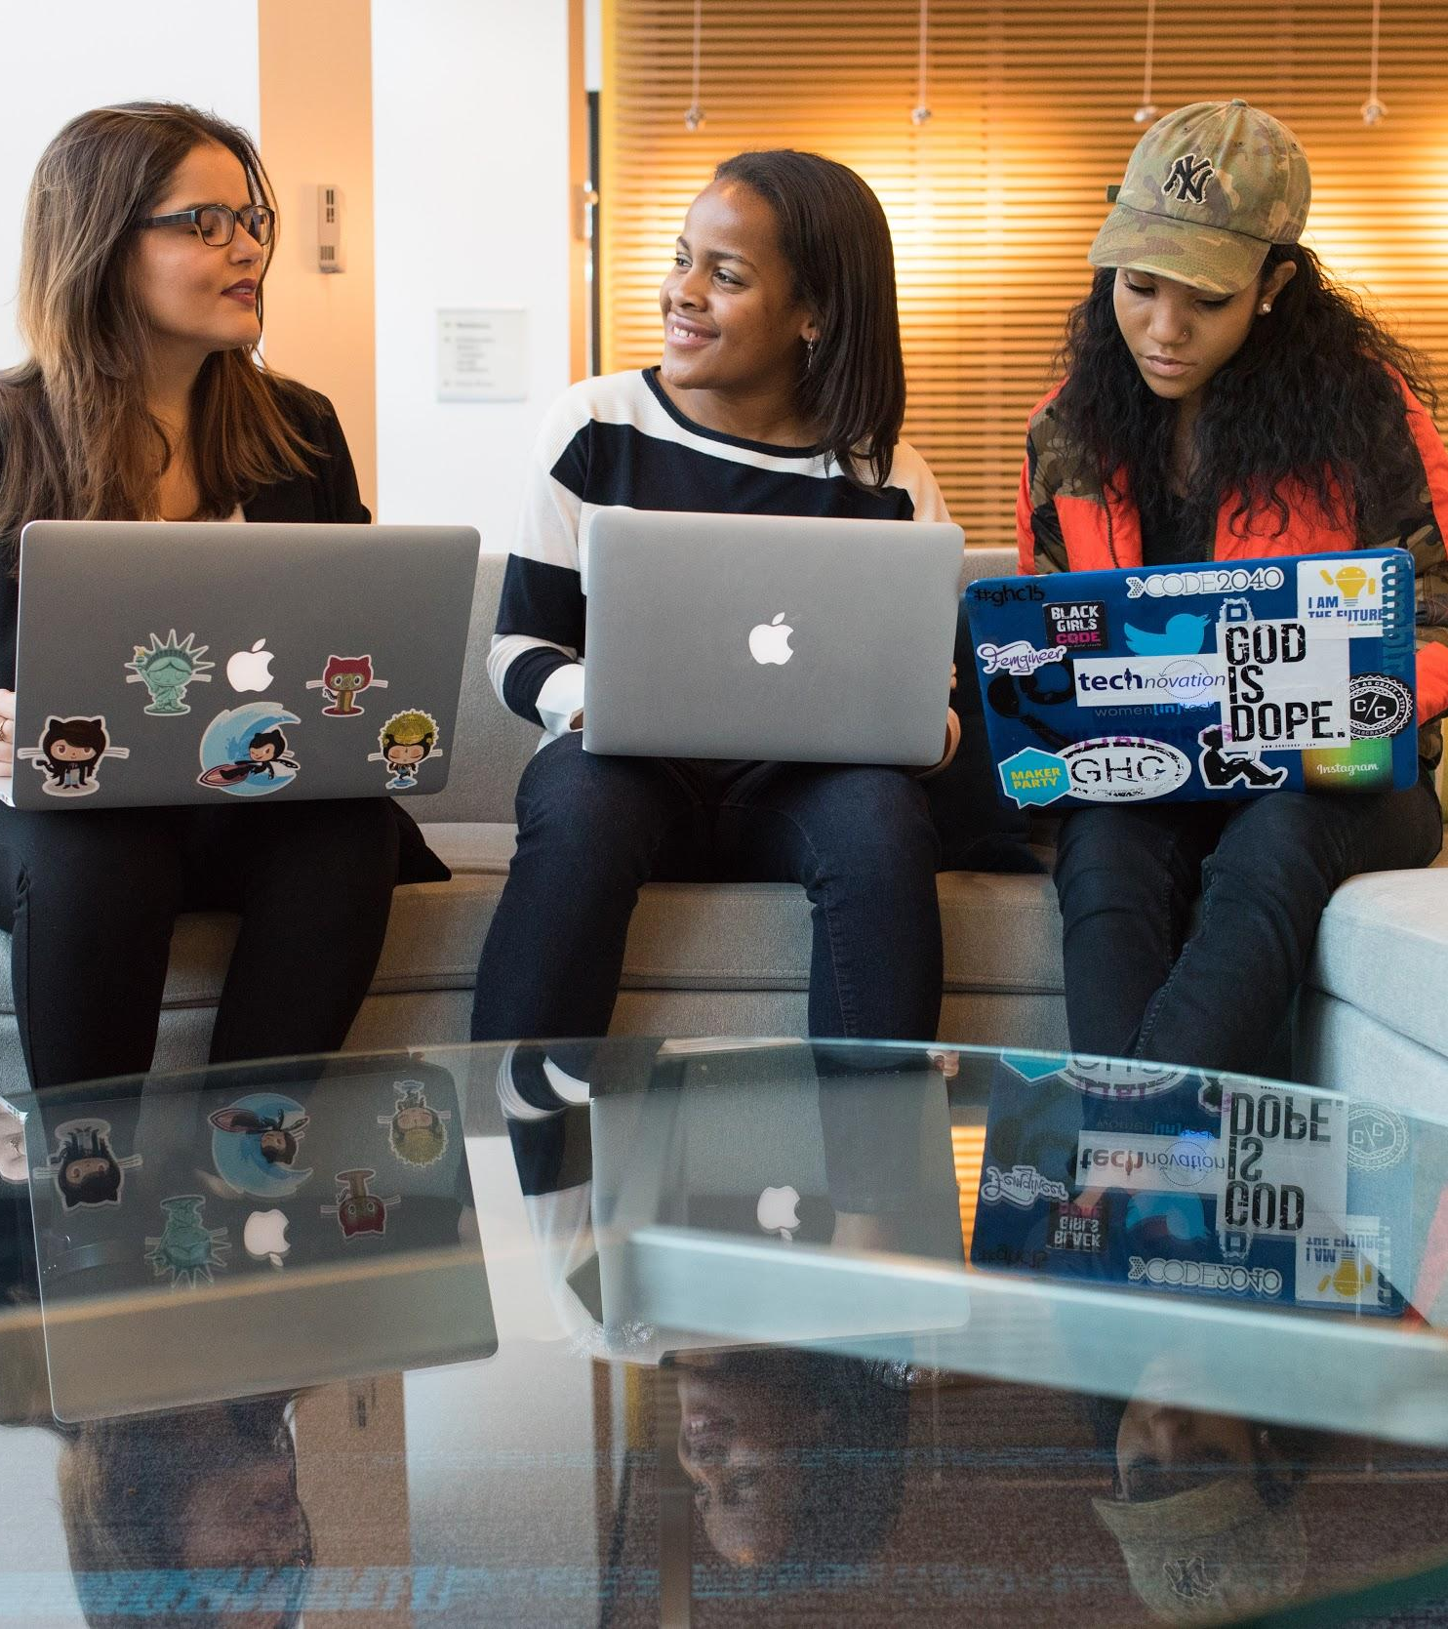
Your Turn
In 30 seconds or less, please share:
Name
Location
Background (Career, Education, Interests)
One Fun Fact about yourself

Slide 5


Introduce Yourselves!
Take 7 minutes to discuss with a partner...
What concerns do you have about the upcoming bootcamp experience?

Slide 6

Success
Keys to

Slide 7

Why are you here?
A majority of you said…
A New Career

Slide 8

Your Goals
Why a career change?
To escape a dead-end job…
To pursue a dream…
To be able to create…
To follow a fascination…
To attain financial stability…
To attain financial freedom…
To challenge yourself…
To become a role model...

Slide 9
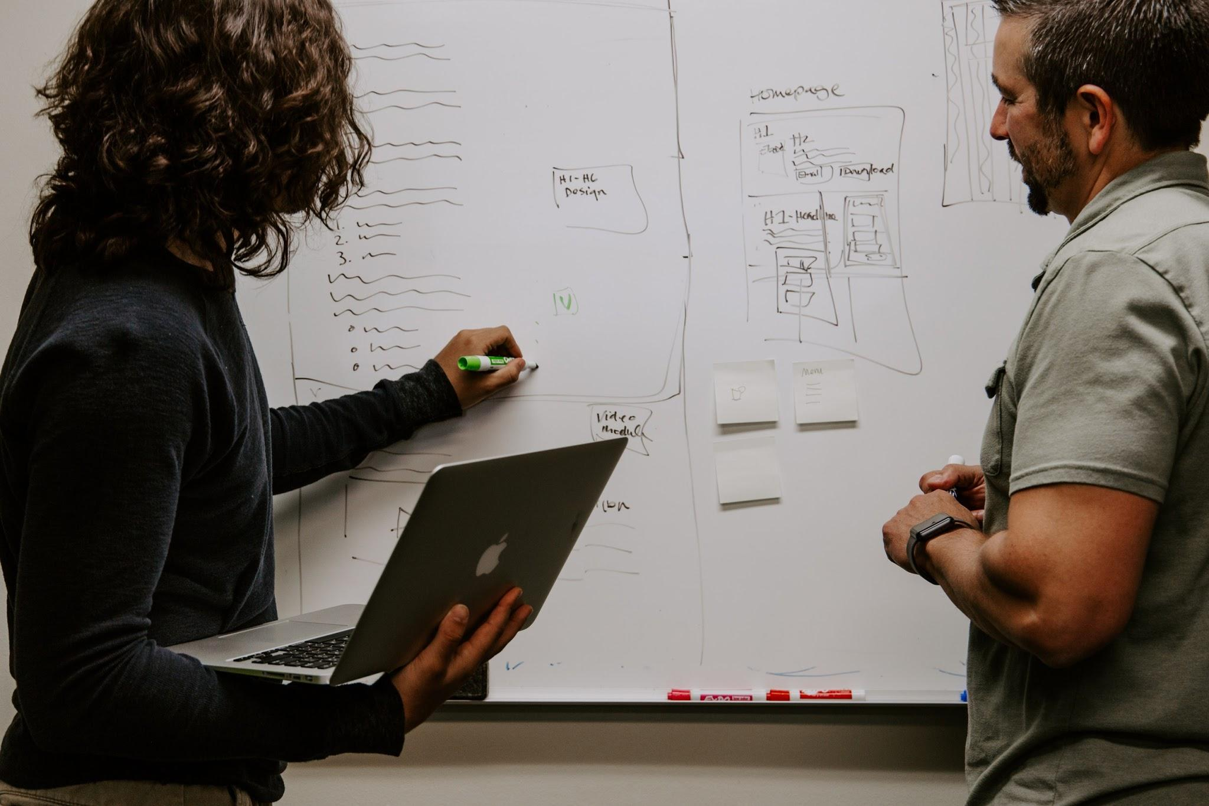
As your instructional team,
we care about your goals.
Your Goals === Our Goals

Slide 10

Our Promise
If you’re willing to put in the time – and you take our advice, we’re here to help you 100% of the way
This goes for everyone working behind the program...
Instructors
TAs
Student Success Team
Career Coaches
Everyone Else!
BUT YOU NEED TO PUT IN THE TIME

Slide 11

Student Instructional Staff Support
1:1s TA Office Hours (9:15-10am, 2:30-3pm) M-F
Review Breakout Room - for reviewing recent class content ( Manuel )
Homework Breakout Room - for students to work on Homework
Tutoring
Starting in Week Two
Procedure listed on Gitlab
Learning Assistant
Online 1:1 support - Expect to receive support from Learning Assistants in under 30 minutes (during active Hours)
See Gitlab for instructions
Organized Repository of all Activities and Concepts: Gitlab
Activities to review
Video Walkthroughs

Slide 12
Where do I…?

Slide 13

Tour

Slide 14

Tour

Slide 15
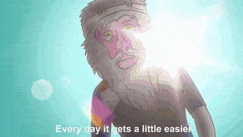
Code Drills
Required / Expected

Slide 16
Remember...
Nothing good comes easy.

Slide 17

Student Expectations
Attendance
Attendance must be maintained at a 95% rate.
(You can miss no more than a total of 4 classes.)
Homework
You must complete 90% of the homework assignments.
(You can miss no more than 2 assignments.)
Homework submissions must be on time AS IS.
Late submissions will not be counted.
Outside Class: 40 hours
Required 40 hours of outside work
- Redo, review, go deeper

Slide 18
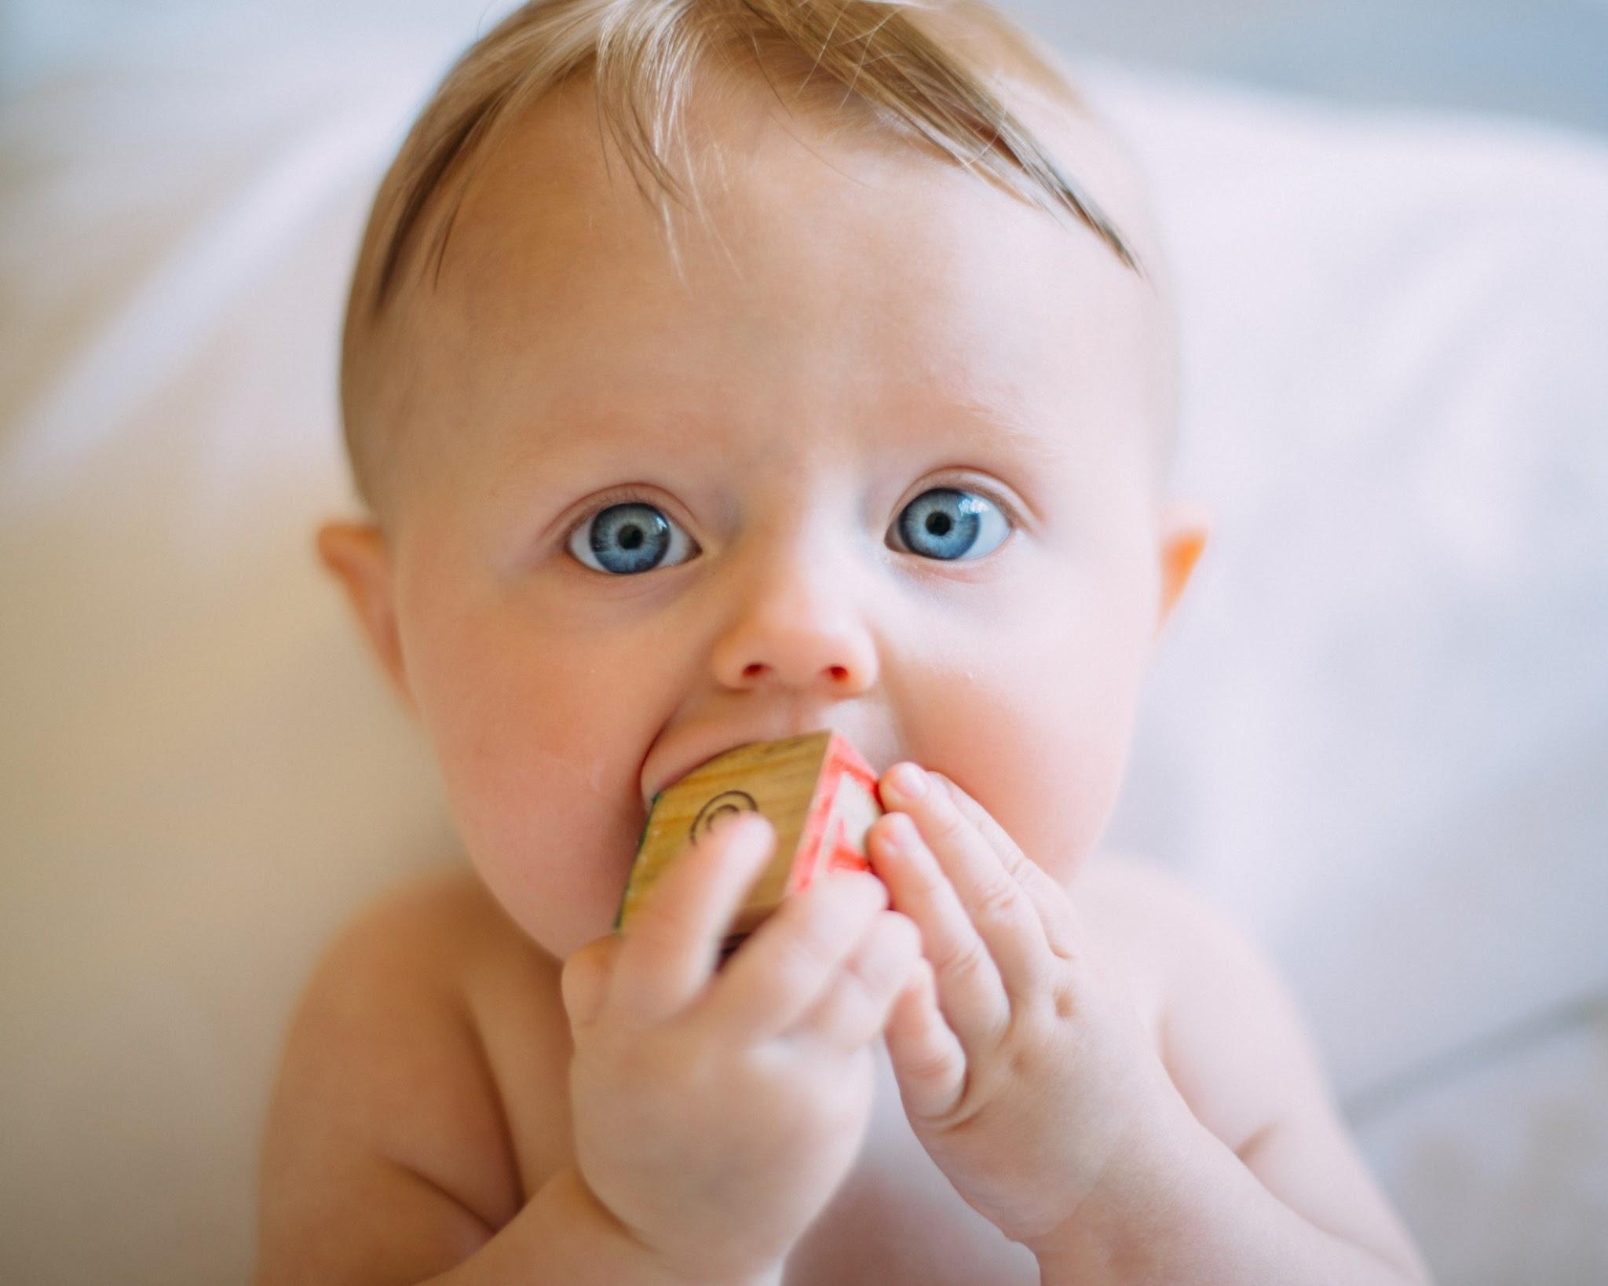
This should be you...

Slide 19
Our mantra for today and beyond...
When it comes to Web Development...

Slide 20
I know nothing...

Slide 21

The path of
Learning

Slide 22

Nothing comes easy...
As students, you will face
three huge obstacles

Slide 23

Obstacle 1 - The Great Confusion
My code works… my code doesn’t work...

Slide 24

Obstacle 2 - The Great Doubt
Imposter Syndrome is a real thing. Don’t let it deter you!

Slide 25

Obstacle 3 - The Great Distance

Slide 26
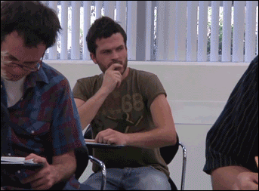
Learning to Code
Persisting in the face of something that feels incredibly hard and confusing.
Maintaining the self-confidence necessary to believe that YOU CAN DO THIS

Slide 27
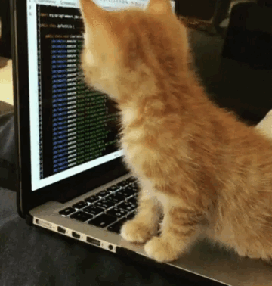
Learning is Frustration
“You can’t tell whether you’re learning something when you’re learning it—in fact, learning feels a lot more like frustration.”
“What I’ve learned is that during this period of frustration is actually when people improve the most, and their improvements are usually obvious to an outsider. If you feel frustrated while trying to understand new concepts, try to remember that it might not feel like it, but you’re probably rapidly expanding your knowledge.”
Jeff Dickey, Author of Write Modern Web Apps with the MEAN Stack: Mongo, Express, AngularJS, and Node.JS

Slide 28

Work Hard
Advice for the Journey

Slide 29

Appreciate your successes
Advice for the Journey

Slide 30
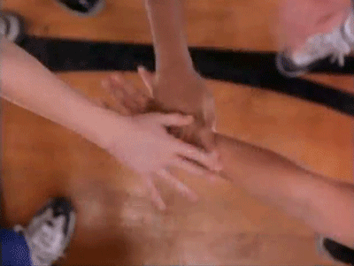
If you want to go fast, go alone.
If you want to go far, go in a team.
Advice for the Journey

Slide 31
Course Structure

Slide 32

Daily Schedule
For each class we’ll run through the following:
Set Objectives
Brief Background Lecture
Coding Demos
Code Discussions
In-Class Exercises
Project Work

Slide 33

Daily Schedule
For each class we’ll run through the following:
Set Objectives
Brief Background Lecture
Coding Demos
Code Discussions
In-Class Exercises
Project Work
The Super Important Stuff

Slide 34

The Super Important Stuff: Always be coding!
Code Discussions, In-Class Exercises, Project Work
Build on your ability to speak about your code
Build on your ability to break down problem sets
Projects
Portfolio Building for the market
Interviewing topic Discussion
Demonstrate your ability learn quickly and build

Slide 35
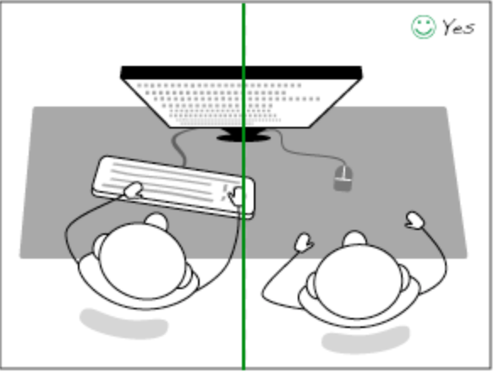
Collaborative and Individual Learning
Pair and Group Discussion
In Class Pairing Sessions
Group Project Work
Pair Presentations / Code & Concept Walk Through

Slide 36
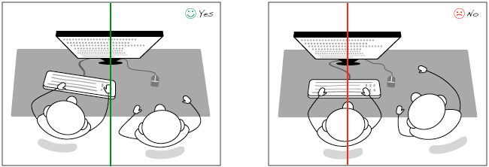
Working Together - Pair Programming

Slide 37
Pair Programming
Pair programming is an agile software development technique in which two programmers work together at one workstation.
One, the driver, writes code while the other, the observer or navigator, reviews each line of code as it is typed in. While reviewing, the observer also considers the "strategic" direction of the work, coming up with ideas for improvements and likely future problems to address. This frees the driver to focus all of their attention on the "tactical" aspects of completing the current task, using the observer as a safety net and guide.
* The two programmers switch roles frequently (once per activity)

Slide 38

Setting Expectations
Don’t expect to understand everything at once. It is all about getting immersed.
More time === greater depth of understanding

Slide 39
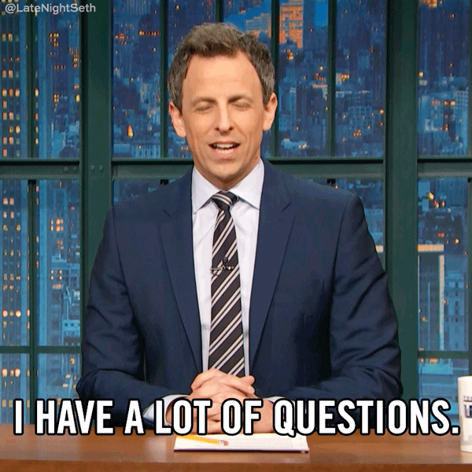
Asking Questions
In Class Question Flow Response
“Sure that’s on topic”
“That is Slightly off topic but interesting, did you google it?” – Google Fu
“That is not on track for today’s objectives - Slack me and the TAs the question and we can chat about it.

Slide 40

GoogleFu
The most important skill that every developer must master...

Slide 41

Student Support
Learning Assistant Support
What do Learning Assistants do?
The Learning Assistant team is here to provide clarity in your learning journey. On the other end of every question you ask, is a Learning Assistant who is ready to help guide you in the right direction - even outside of standard classroom times!
How do I get support from Learning Assistants?
In the #learning-assistant channel of your class’ Slack workspace, you can utilize a slash command ("/ask") to post an anonymous question to be answered by a Learning Assistant.

Slide 42
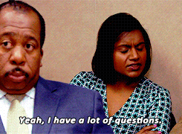
Student Support
Posting questions to slack
Pick the appropriate channel
#homework
#technical-questions
Post your question with the following information:
What is the issue you are encountering?
What have you attempted?
What are the errors (if any) that you are receiving?
Attach any screen shots that are relevant.
Link to your Github repo with latest code

Slide 43

Pre Work Checklist
At this point, you should have each of these installed:
Slack (Open up the desktop application)
Visual Studio / Sublime / Atom (Open It)
Git Bash (Windows) or Terminal (Mac)
Node.js (In Terminal Type Node / ctrl+c to exit)
Google Chrome (Open It)
Git for Version Control (Type git In terminal)
GitHub accounts tied to their local Git using SSH authentication: ssh -T git@github.com

Slide 44

Accounts Checklist
You should also now have accounts for:
GitHub (with SSH Integration)
LinkedIn
Stack Overflow

Slide 45
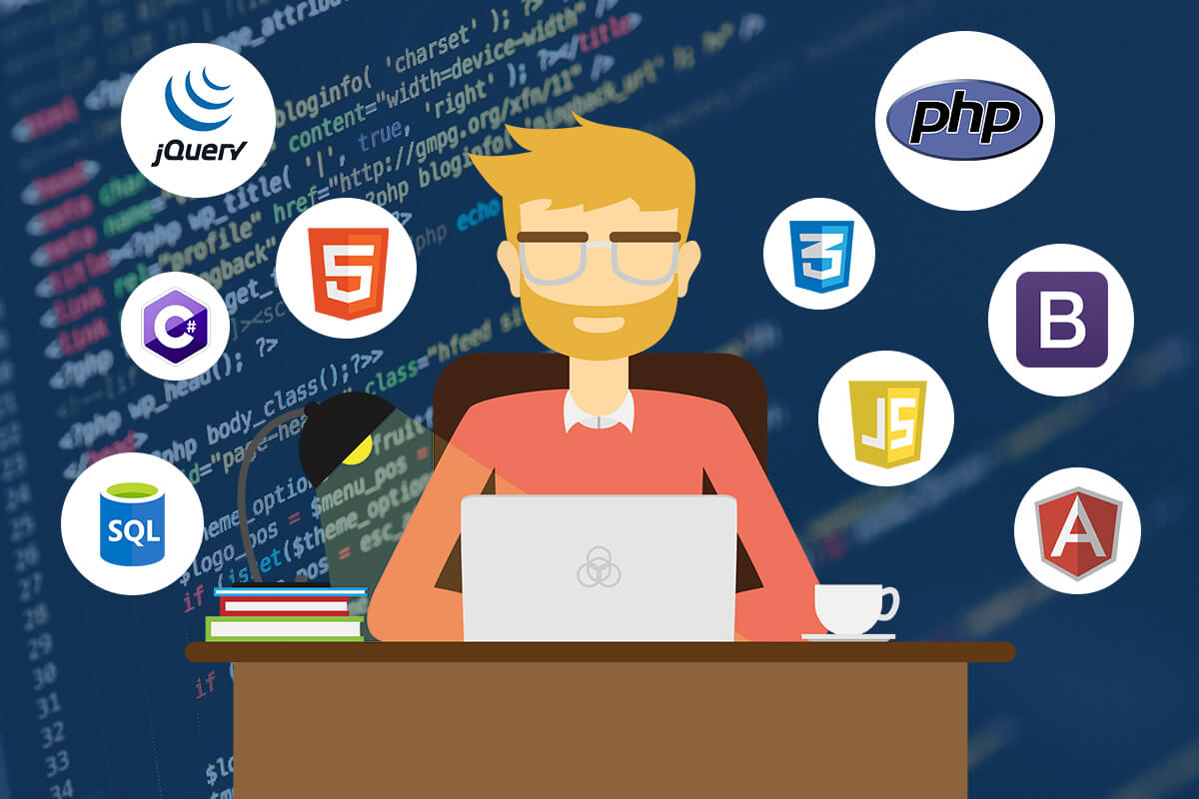
Full Stack Developer?

Slide 46




Full-Stack Development
Request Response Cycle
In modern web apps, there’s a constant back-and-forth communication between two key components: the visuals displayed in the user’s browser (front end) and the data and logic stored on the server (back end).
Browser shows webpage to user
Web browser
Front end
User requests a webpage
Browser talks to Express
Express sends HTML back to browser
MySQL database
Node sends SQL
Node.js Express.js
Back end
MySQL returns rows
Node passes data to Handlebars
Handlebars renders HTML
Handlebars

Slide 47
Full-Stack Development
Request Response Cycle
Full-stack development is the concept of building every aspect of the web application— from the visuals and interactions to the data transfer and processing.
Browser shows webpage to user
Web browser
Front end
User requests a webpage
Browser talks to Express
Express sends HTML back to browser
MySQL database
Node sends SQL
Node.js Express.js
Back end
MySQL returns rows
Node passes data to Handlebars
Handlebars renders HTML
Handlebars

Slide 48
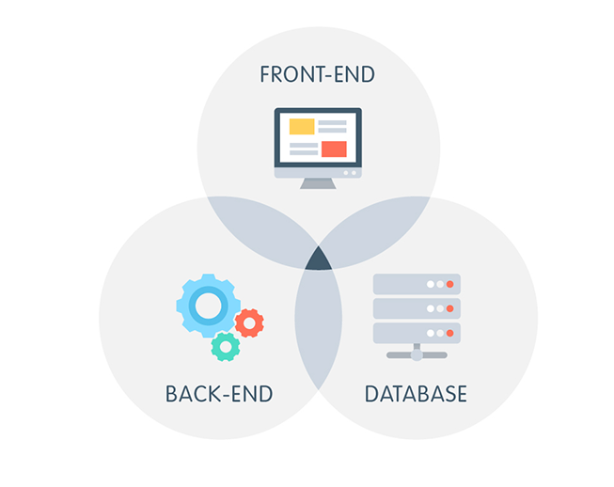
Browser
HTML
CSS
JavaScript
jQuery
Bootstrap
SEO
Dev Tools
Heroku
Git & Github
Databases
MySQL
MongoDB
Server Side
Templating Engines
Sessions
Creating APIs
MVC
User Authentication
ORM (Sequelize)
Node.js
Express.js
M.E.R.N.
API Interactions
APIs (Consuming)
JSON
AJAX
Real Time Cloud Database via Firebase
Cutting Edge
React.js
CS Fundamentals
Algorithms
Design Patterns
OOP
Big O Notation
MongoDB | Express
React | Node

Slide 49
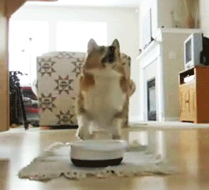
It’s Lunch Time!
Return @ XX:XX

Slide 50

Intro to Console / Terminal
TA Demo

Slide 51
Your Turn!
Activity: Get Situated | Suggested Time: 5 mins
Assignment:
Make a folder on your desktop named holding-tank.
Using your GUI finder / explorer put all files on your desktop in the holding-tank directory
Best Practices:
Always use lowercase for folder and file names.
Never put in spaces in your folder and file names.
Use dashes to separate.

Slide 52
Your Turn!
Activity: Console Commands | Suggested Time: 12 mins
Assignment:
From the Terminal / Console and using only the command line, create:
A new folder with the name of first-day-stuff.
A new HTML file with the name of first-day.html.
Open the current folder containing the new HTML file.
Bonus:
Create multiple directories/folders with the names one-folder and second-folder in one command.
Create multiple files with the names one.html and two.html in one command in the first_day_stuff directory.

Slide 53

Discussion Time!
Turn to the person next to you…
and *gasp* talk to them!

Slide 54
Hello HTML!
Let’s Have a look

Slide 55

<title>Intro to HTML</title>
HTML is one of the three base languages behind every single website.
It defines all of the basic content and a bit of formatting.

Slide 56
Your Turn!
Activity: Intro to HTML | Suggested Time: 10 mins
Assignment:
In a new HTML file, create the basic structure of an HTML document and include the following in it:
DOCTYPE declaration.
Head tag with a title tag.
H1 tag with a title of your choice.
Embed an image.
Create the following three links on your page:
One link that is target="_blank" so that it opens a new tab when clicked on.
Make the second link bold.
Make the third link a placeholder so it goes nowhere.
Bonus:
Create an ordered list of steps to make a sandwich.
Create an unordered list of 5 bands/musicians you like.
Create a table with 2 columns (animal class and animal name) and 4 rows of animals.
Use an alternate way of separating links without line breaks.
Embed a YouTube video of your favorite band/musician.

Slide 57

So… How’d It Go?

Slide 58
What is Git?

Slide 59
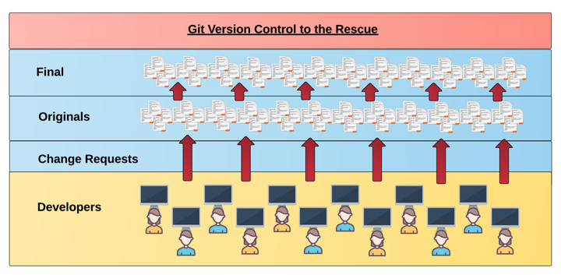
Collaborative Coding
Modern web development is highly collaborative.
Teams are often extremely large and separated across the country — or planet.
Apps sometimes comprise hundreds or even thousands of files.

Slide 60
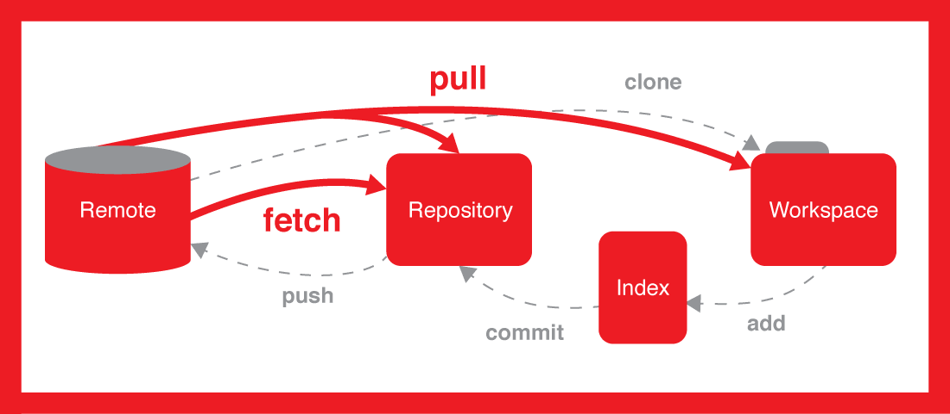
Version Control
Provides a organized system for managing code for when multiple developers work on a project
at the same time.
The Benefits of Git:
A process for resolving conflicts in code.
Version History:
rolls back the code to an earlier version.

Slide 61
Git Demo

Slide 62

What is Github?
GitHub is a Web-Based hosting service to store code online.
It allows developers to pull (download) code or push (upload) code to the same repository (directory).
It also allows developers to view histories of code changes and to track issues.

Slide 63
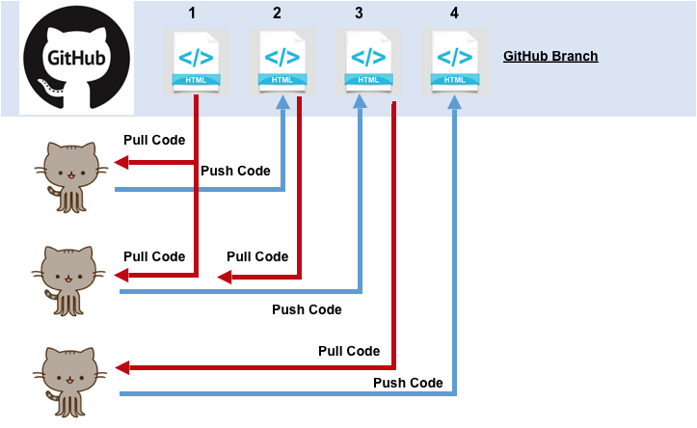

Slide 64
git started with git (LOL) Git Demo / Github Repo

Slide 65
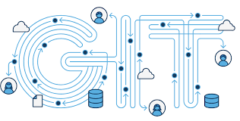
Git Commands
This is the holy grail, the 6 git commands that you should engrave into your brain. Soon they will become second nature. You will git it eventually.
git clone - copy a repo
git status - check status of tracked files
git add - add a file to be git tracked
git commit - notes a change to local repo
git push - sends changes to cloud/host
git pull - downloads latest version of repo

Slide 66
Let’s Git
Activity: myClass Repo | Suggested Time: 20 mins
Using GitHub and the Command Line:
Create a new private GitHub repository and name it my-class-repo Be sure to check the box for “initialize this repository with a README.”
Next, clone the repo to your local directory.
Using your finder or explorer copy the README.md and course-content into your new directory
Add, Commit, and Push the code to GitHub.
Slack the link to your new repo to the Private 0-firstname-lastname channel

Slide 67

Goals for next class…
Figure out where the GitLab Repo is for our class.
Re-do the Terminal example from class today.
Re-do the HTML example from class today.
Watch the Walkthrough Video if you felt a bit lost.
Review the Git commands we learned and how to use them
Do some of the code drills

Slide 68
Zoom Class Password
Notes:
DEMO GIT

Slide 69

Farley
(farley/bacon =>foo bar)
Asher
(filth lord)

Slide 70
Zoom Class Password
farley
Starting Tomorrow
Notes:
DEMO GIT

Slide 71
Homework on the first day?
Notes:
DEMO GIT

Slide 72

Yes
Notes:
DEMO GIT

Slide 73
Homework Demo
Notes:
DEMO GIT

Slide 74
Mac Users Hang Back
Notes:
DEMO GIT

